Slide 1
Canny Edge Detector Parallelization in CUDA
By: Alex Varvel, Daniel Collins, Anil Reddy-Peddolla

Slide 2
Overview
Canny Edge Detector Overview
CUDA Overview
Implementation
Infrastructure
Serial Implementation
Parallel Implementation
Results
Analysis
Conclusions

Slide 3
Canny Edge Detector Overview
High level goal: Detect edges in an image
Uses 5 different filters
Gaussian Blur
Intensity Gradient
Non-Maximum Suppression
Double Threshold
Edge Tracking Hysteresis
Used heavily in current image processing algorithms

Slide 4
CUDA Overview
GPGPU API developed by nVidia in 2007
Version 7.5 used in this project
Coded in C++, compiled using NVCC
CUDA code only runs on nVidia graphics cards
Data-parallel programming model
Very common platform in the parallelization/image processing industry
CUDA allows users to break up “work” into a parallel hierarchy
Grids, Blocks, Threads
Task level parallelism via Streams

Slide 5
Implementation: Infrastructure
Uniform environment:
FAB Computers
Used to develop code so each user had an identical hardware setup
Running code for grading purposes will be straightforward
NVCC nVidia Compiler and nVidia video cards
Magick++ Image processing library
Used to process image from standard formats (.jpg/.bmp/.png/etc.) and turn them into a flat buffer of “pixels” which were manipulated.
GitHub
Used for version control/code sharing/issue and bug tracking

Slide 6
Implementation: Serial
Coded a Canny Edge Detector in standard C++ to run on a single CPU with a single thread
Nested “for” loops used to iterate over each pixel serially
Used as a timing baseline (slowest implementation)
Allowed us to debug algorithms in a predictable manner
Easier to reason about a serial program
Mature debug toolchain
Enabled us to understand problem space and algorithm structure

Slide 7
Implementation: Parallel
Coded a Canny Edge Detector in C++ using CUDA to take advantage of the nVidia graphics card’s plethora of processing units
Split work into one dimensional blocks and threads on one grid
Parallelized serial code using CUDA by using a 1:1 mapping of threads to pixels
Similar algorithms for the parallel implementation but used multi-pass hysteresis
GPU “Shared memory” used when applicable to enhance performance
Streams used to allow for task level parallelism

Slide 8
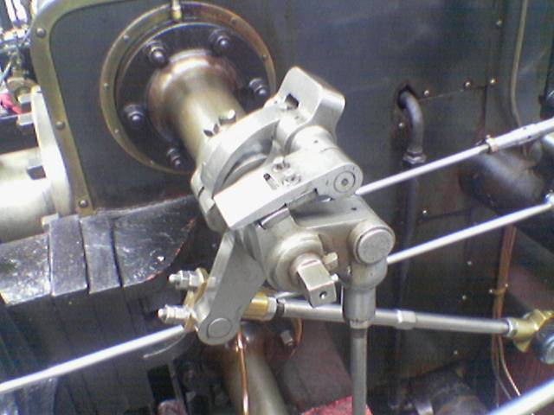
Results
Original Image:

Slide 9
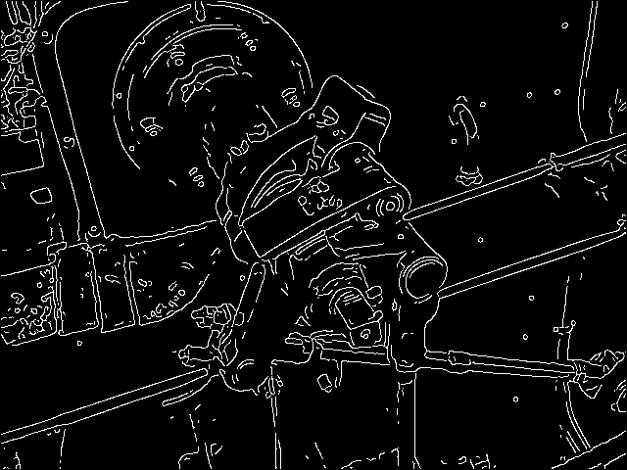
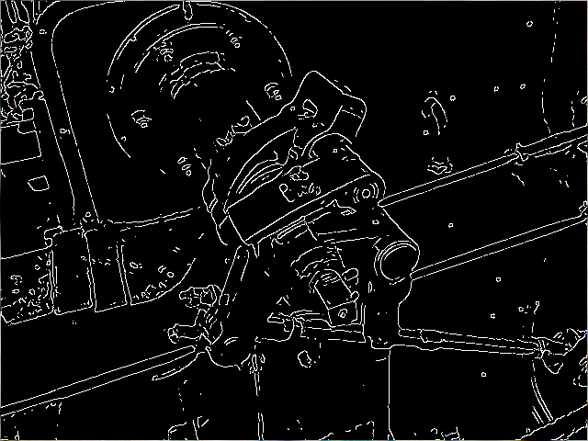
Serial Execution Results
Serial Edge Detected Image:
Reference Edge Detected Image:

Slide 10

Parallel Execution Results
Parallel Edge Detected Image:
Reference Edge Detected Image:

Slide 11
Analysis: Overview
Serial and parallel execution time of edge detection algorithm compared
Swept size of input image
Swept the size of the convolution kernel

Slide 12
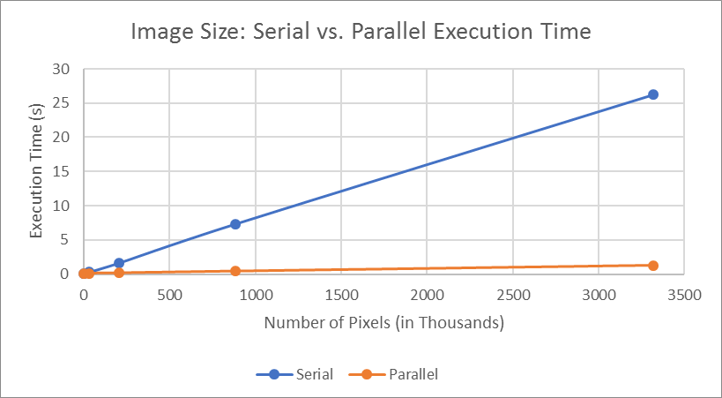
Analysis: Image Size Manipulation
Image Size Manipulation
Image Resolution | Serial Speed (s) | Parallel Speed (s)
70 x 70 | 0.003811 | 0.086464
640 x 480 | 0.270741 | 0.10651
1920 x 1080 | 1.642513 | 0.16379
4096 x 2160 | 7.332309 | 0.405638
7680 x 4320 | 26.205247 | 1.233142

Slide 13
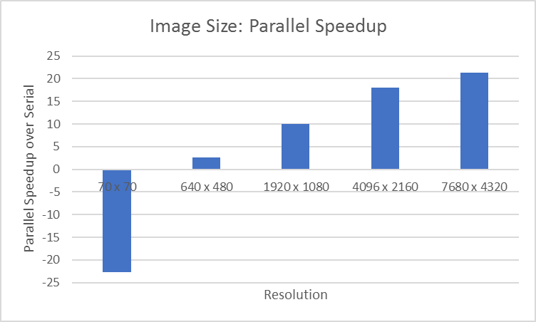
Analysis: Image Size Manipulation
Image Size Manipulation
Image Resolution | Parallel Speedup
70 x 70 | -22.6880084
640 x 480 | 2.541930335
1920 x 1080 | 10.02816411
4096 x 2160 | 18.0759914
7680 x 4320 | 21.25079431

Slide 14
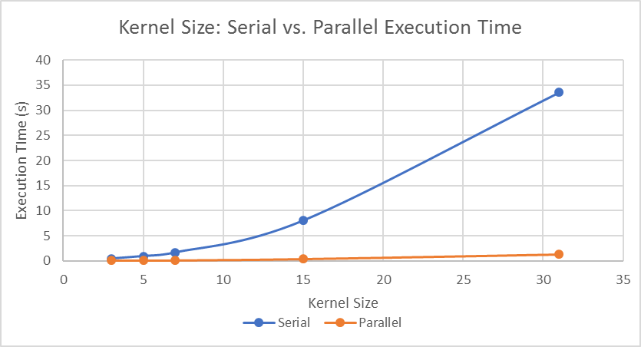
Analysis: Kernel Size Manipulation
Kernel Size Manipulation
Kernel Size | Serial Speed (s) | Parallel Speed (s)
3 | 0.439012 | 0.118802
5 | 0.937175 | 0.136428
7 | 1.642513 | 0.16379
15 | 8.013535 | 0.418164
31 | 33.578706 | 1.28104

Slide 15
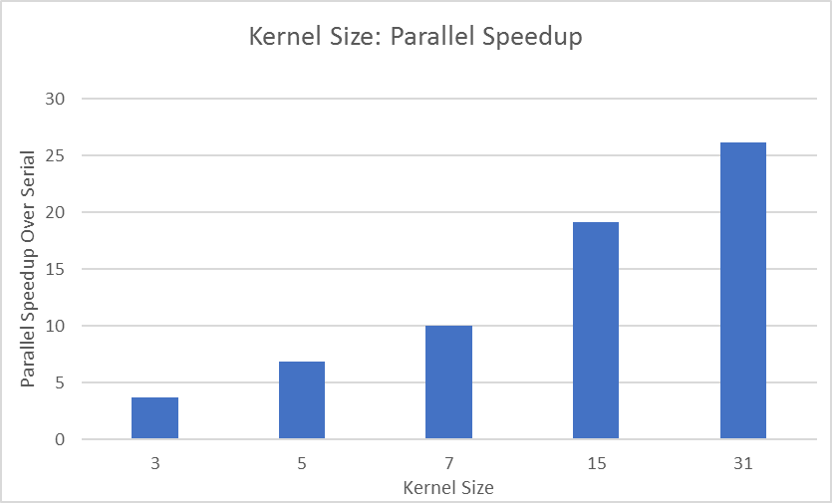
Analysis: Kernel Size Manipulation
Kernel Size Manipulation
Kernel Size | Parallel Speedup
3 | 3.695324995
5 | 6.869374322
7 | 10.02816411
15 | 19.16361762
31 | 26.21206676

Slide 16
Conclusions
Helpful that CUDA task-level mapping, delegate scheduling, and resource assignment abstracted hardware constructs
Taking advantage of memory hierarchy was intuitive
Parallel was significantly faster
Linear increase in speedup as workload increased when comparing parallel to serial
Serial is faster for tiny images
Memory allocation, transfer overhead, PCIe bus transmission
Using a unified system was a very wise decision

Slide 17
Questions?
Thank you!

